Slide 1
A Good Cause
Workshop on Correlation, causation and storytelling at WBEZ

Slide 2

My Goal:
Source: XKCD

Slide 3
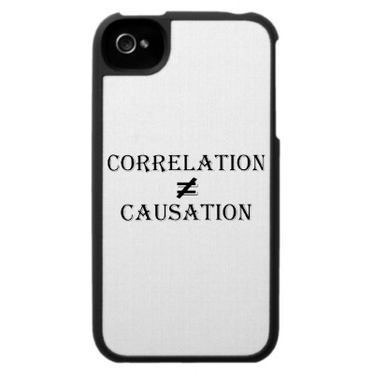
Notes:
We’re going to try and unpack it

Slide 4
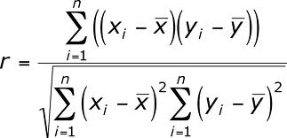
Correlation:
Notes:
Focus on intuition rather than theory. I’ll do a little bit of it for kicks

Slide 5
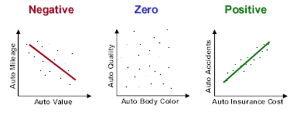
Correlation: a mutual relationship between two things

Slide 6
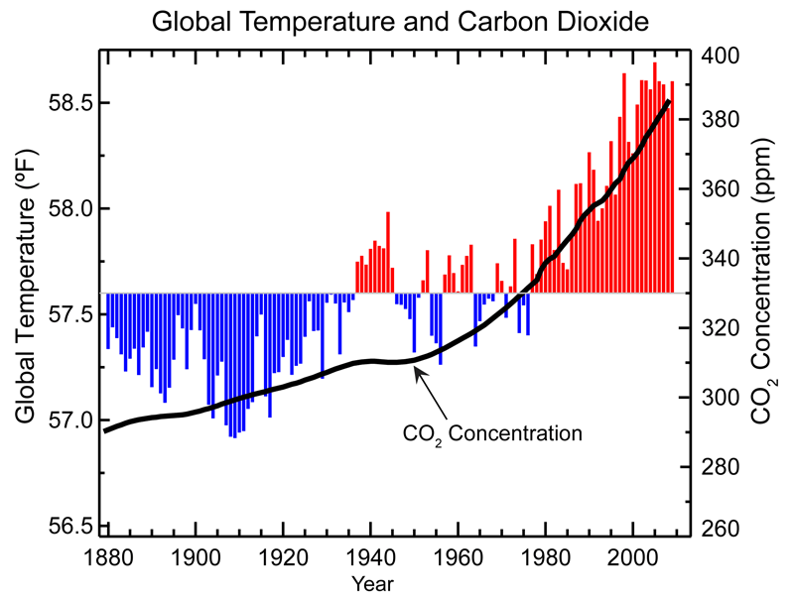
An Inconvenient Correlation?

Slide 7
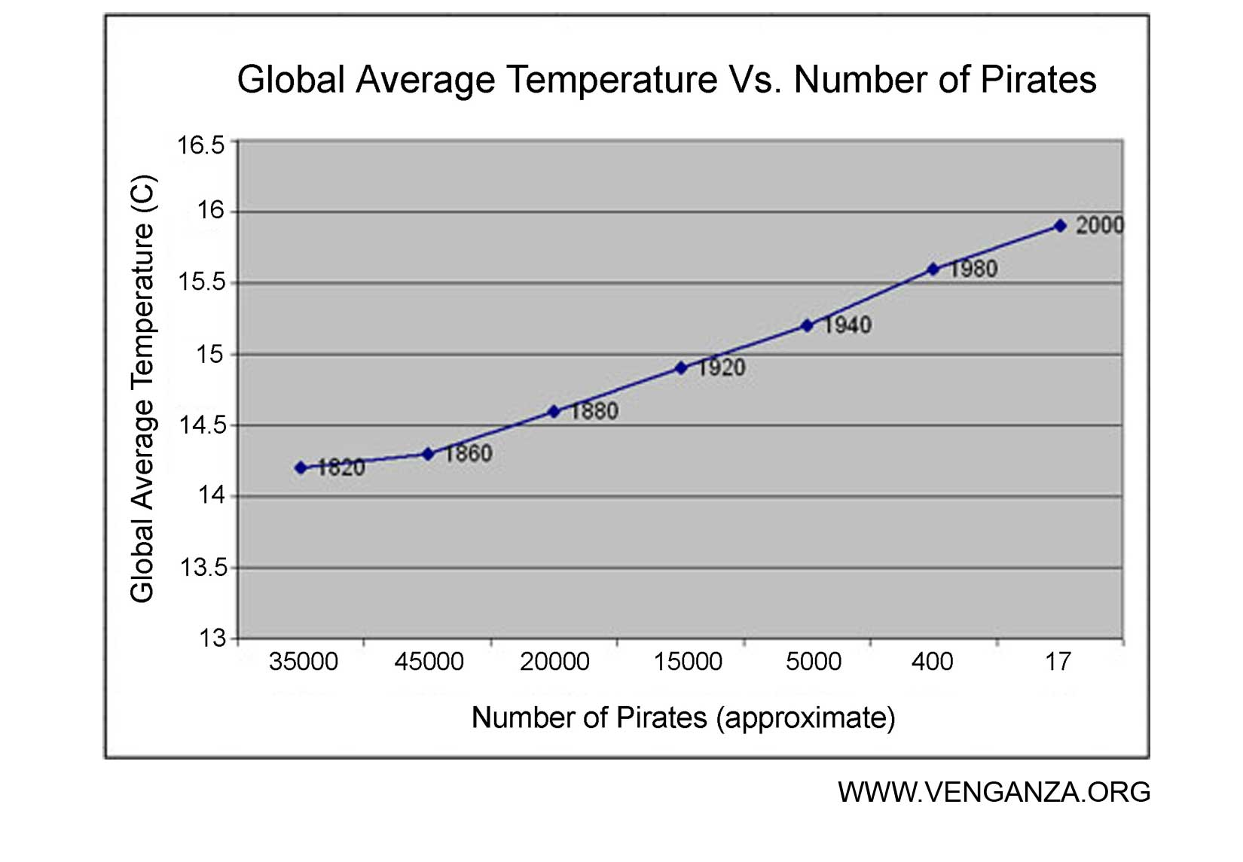
Global Warming
Notes:
Our brains our wired to assume cause when we see relationships

Slide 8
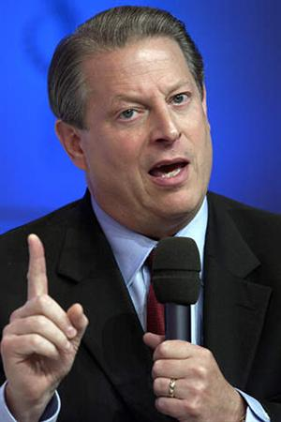
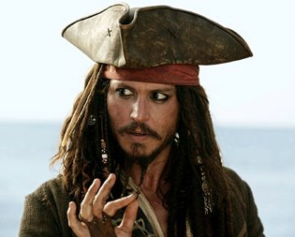
Stop Global warming: become a pirate

Slide 9
Notes:
That

Slide 10
Causation: a Necessary & directional relationship between two things

Slide 11
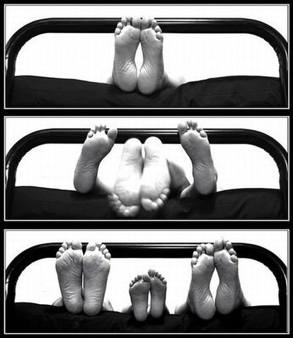
Causation
Event one…
leads to event two.

Slide 12
Hume’s Rules
1. The cause and effect must be contiguous in space and time
2. The cause must be prior to the effect
3. There must be “constant union betwixt” the cause and effect

Slide 13
Global Warming

Slide 14
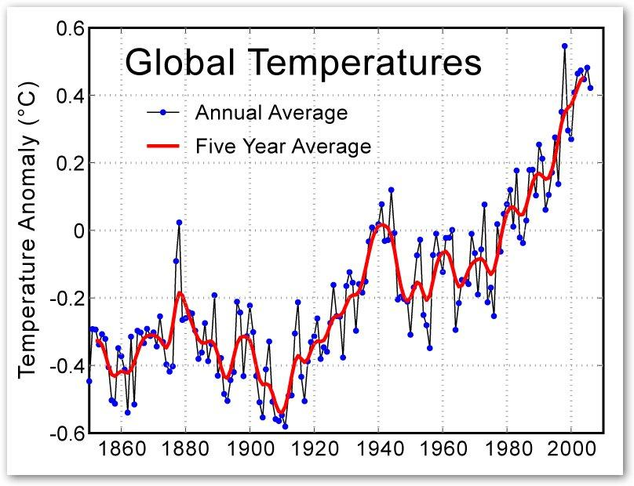

Slide 15
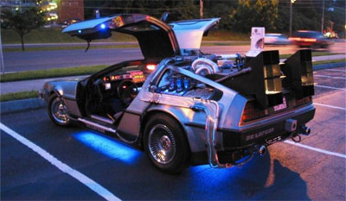
The Fundamental Problem

Slide 16
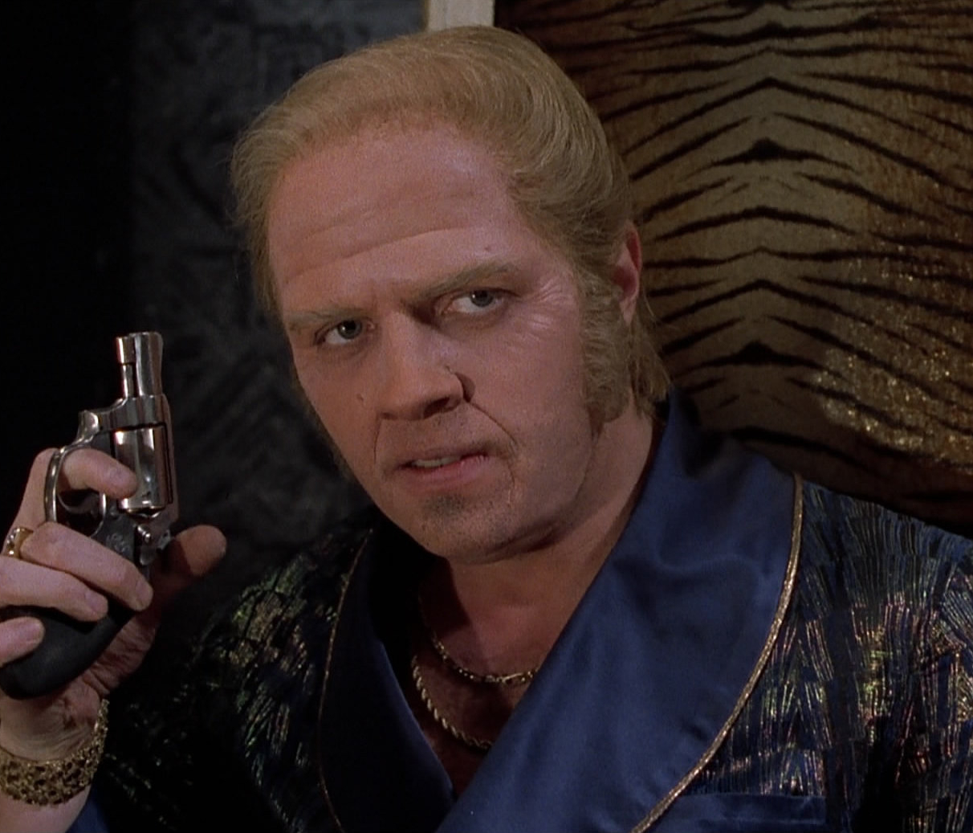
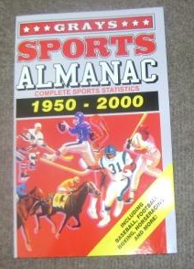
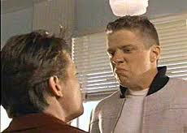
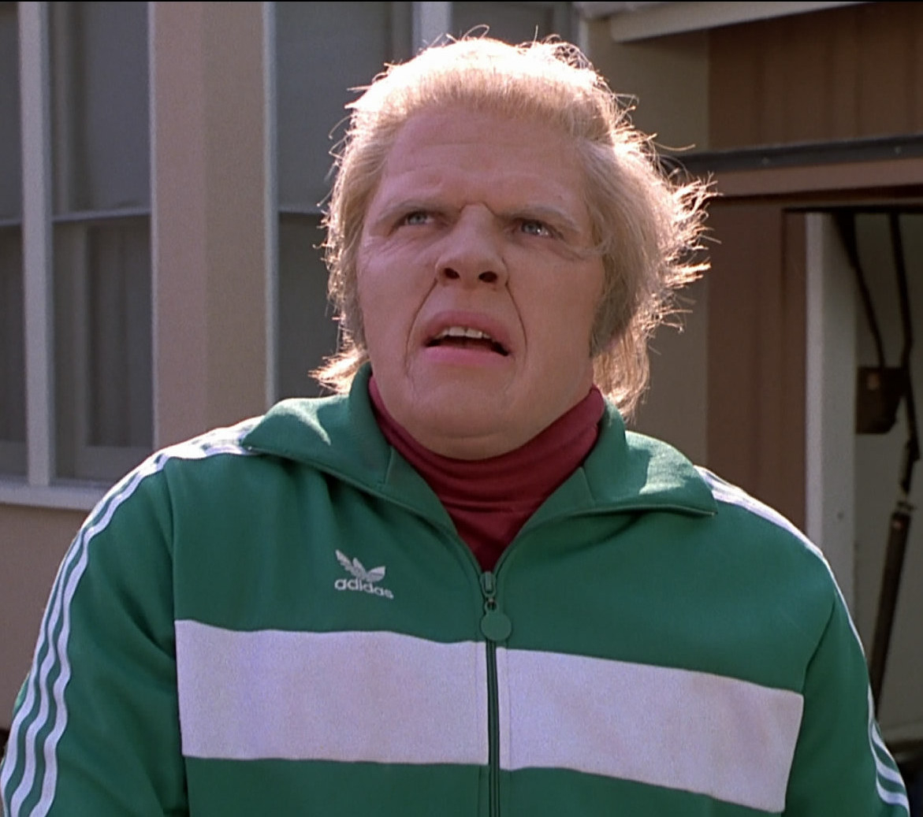

Slide 17
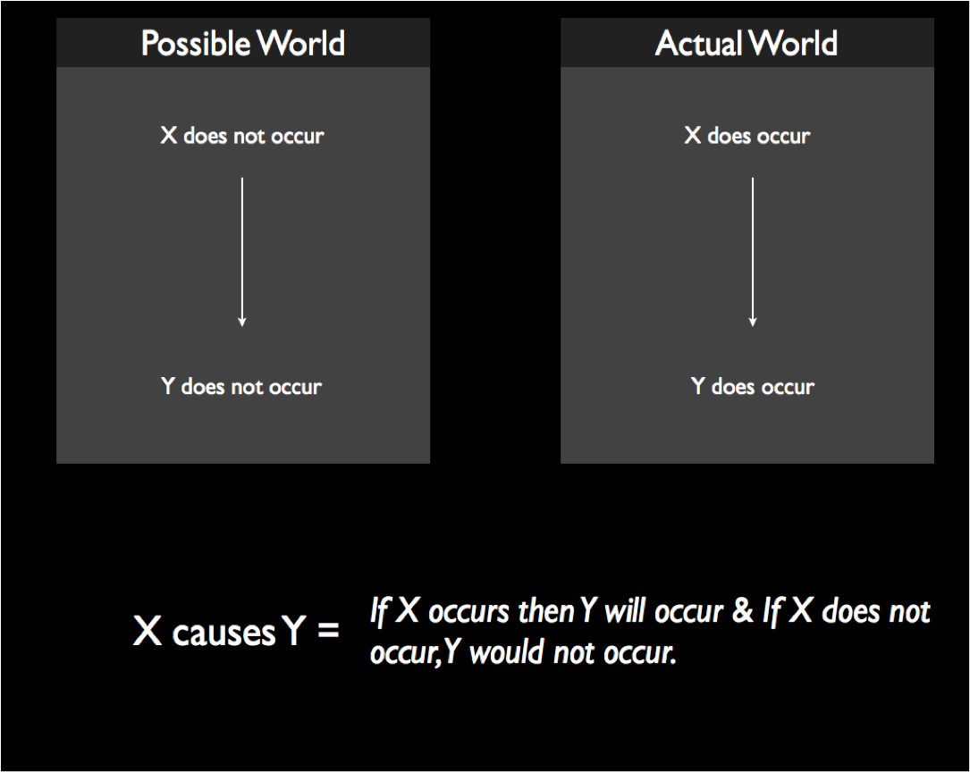

Slide 19
Causal Inference

Slide 20
So many ways to be wrong
We observe A is correlated with B
It could be that A causes B
Or it could be that…
B causes A (Reverse Causation)
C causes A & B (Common cause or External causation)
A causes B and C causes B (Multiple causation)
A causes C causes B (Indirect causation)
C causes A causes B (Reverse indirect causation)
A and B are unrelated (Chance)
Notes:
Focus on intuition rather than theory. I’ll do a little bit of it for kicks

Slide 21
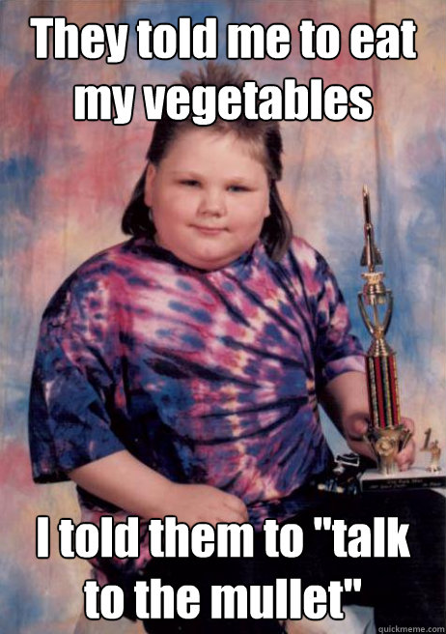
Reverse Causation Children’s BMI and Parental restrictions on diet

Slide 22
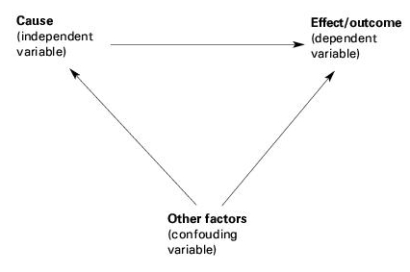
Confounding

Slide 23
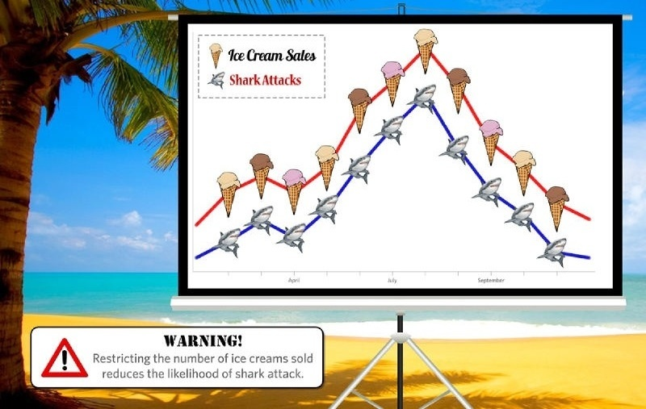
Common cause

Slide 24
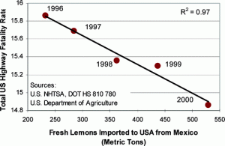
Common trend it’s Just a Matter of Time

Slide 25
Multiple Causation?

Slide 26
Indirect Causation
Chicago Summer of Learning

Slide 27
Omitted variable bias
Selection bias
Measurement error/bias
Singular variable bias

Slide 28

Chance

Slide 29
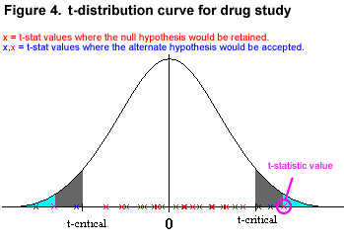
Dealing with Chance: Statistical Inference
Source: cvsg.k12.va.us

Slide 30
How to get it right
Randomized Control Trial
Unexpected Shocks (Natural Experiments)
Instrumental Variables
Cutoffs (Regression discontinuity)
Controlling for other sources of variability

Slide 31
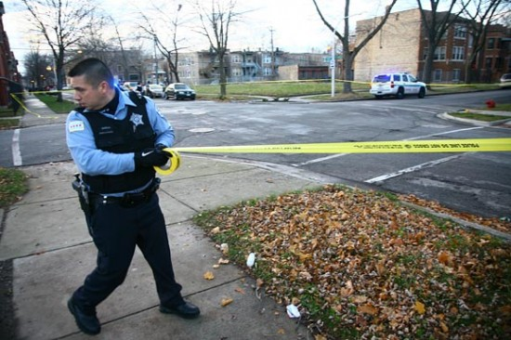
What causes Crime?

Slide 32
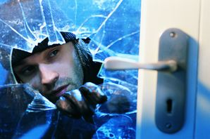
Crime and Temperature

Slide 33
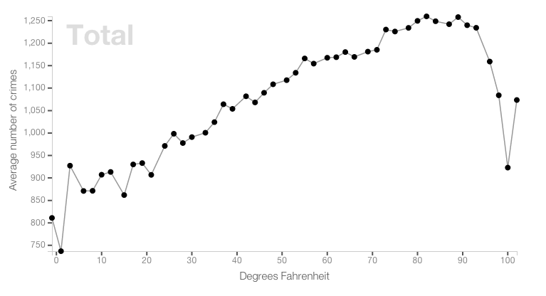
Source: http://www.chicagomag.com/Chicago-Magazine/The-312/May-2013/Crime-Follows-Temperature-In-Chicago/
http://crime.static-eric.com/#top

Slide 34
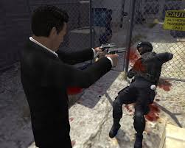
Crime and Video Games

Slide 35
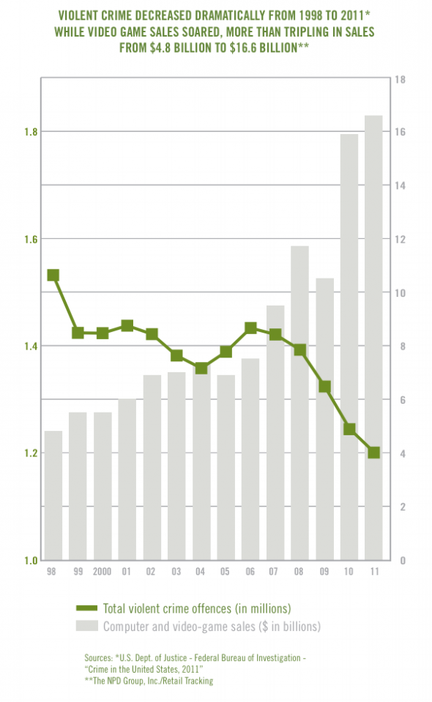

Slide 36
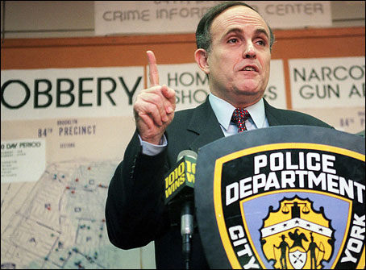
Crime and Giuliani

Slide 37
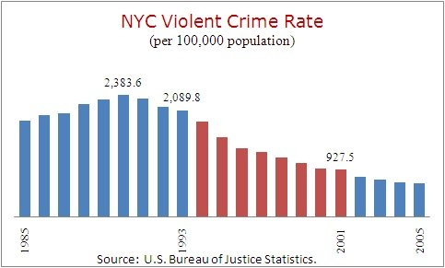
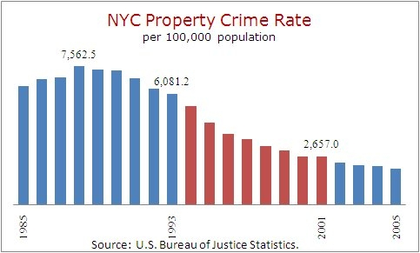

Slide 38
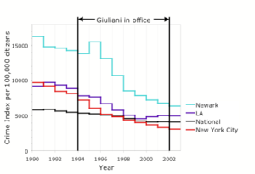
Source: http://www.factcheck.org/

Slide 39
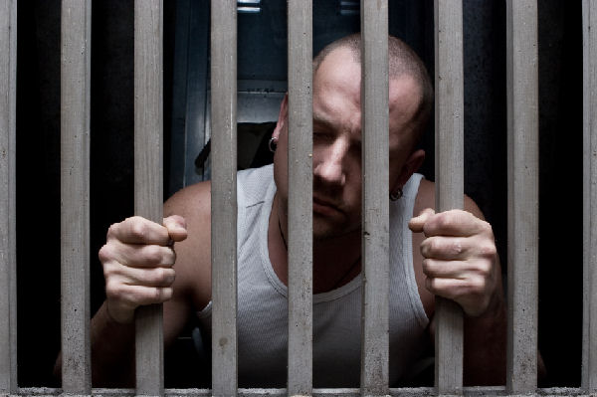
Crime and Incarcerations
Source: http://tcftakingnote.typepad.com/

Slide 40
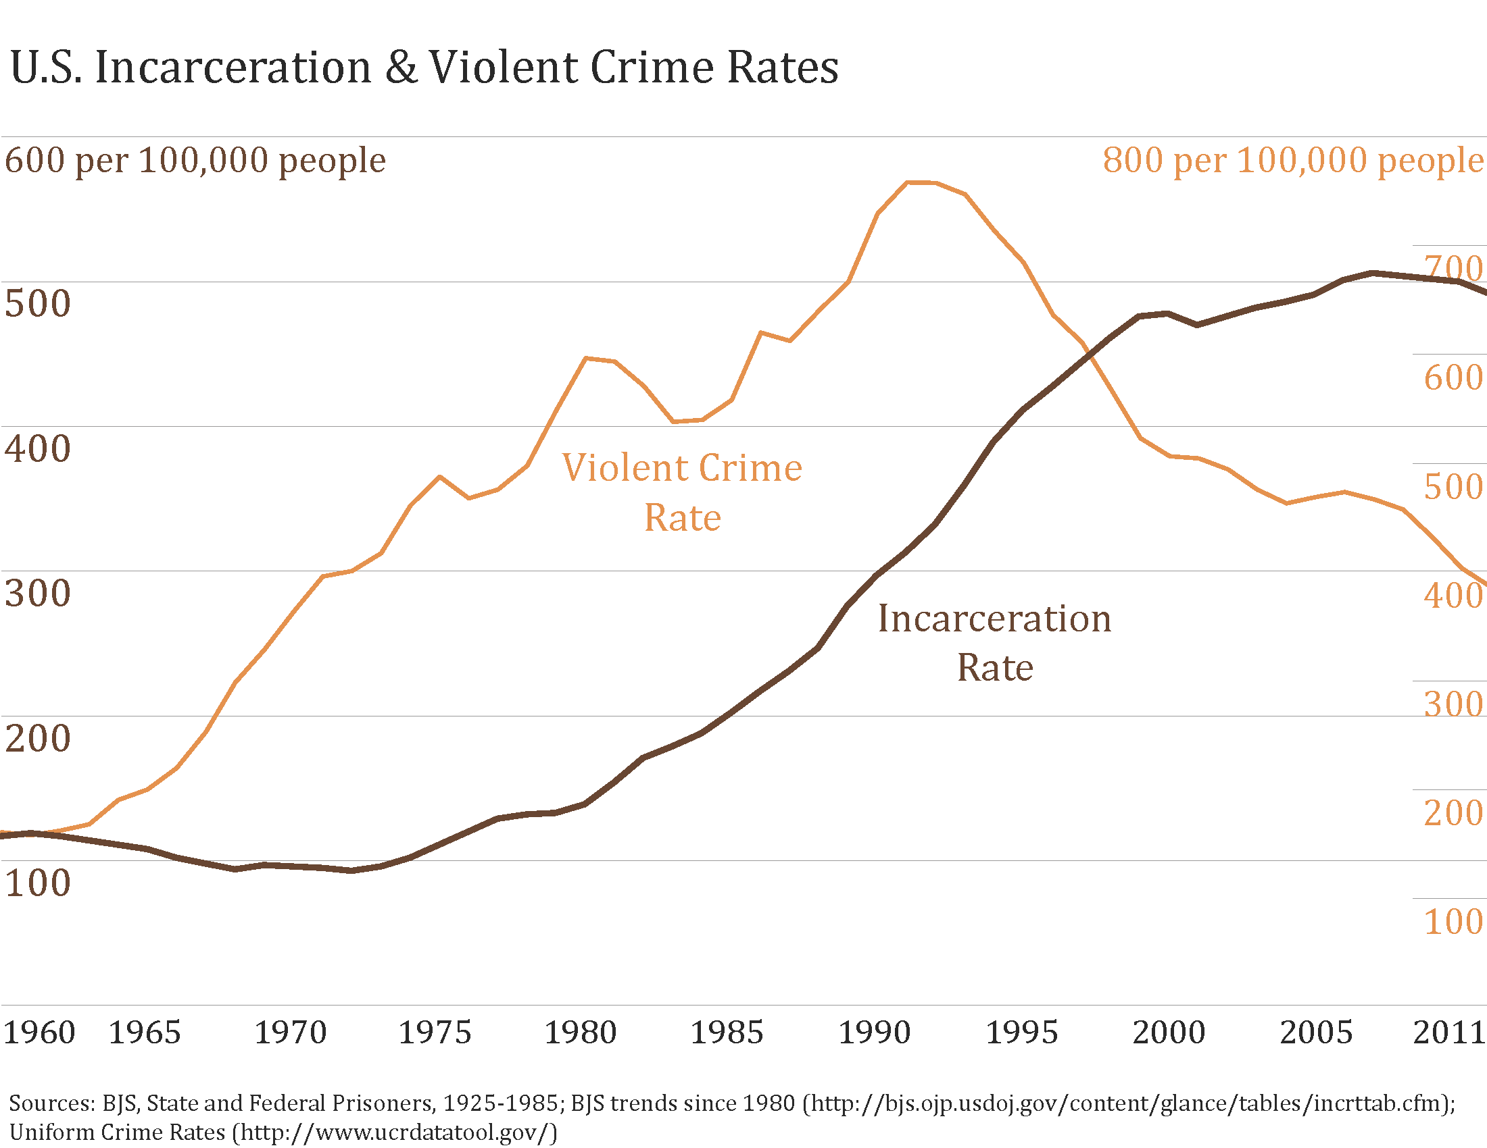
Crime and Incarcerations
Source: http://tcftakingnote.typepad.com/

Slide 41
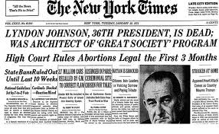
Crime and Abortion

Slide 42
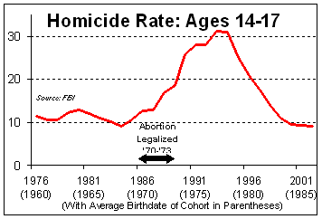
Crime and Abortion

Slide 43
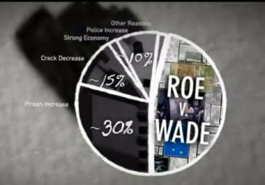
Crime and Everything

Slide 44
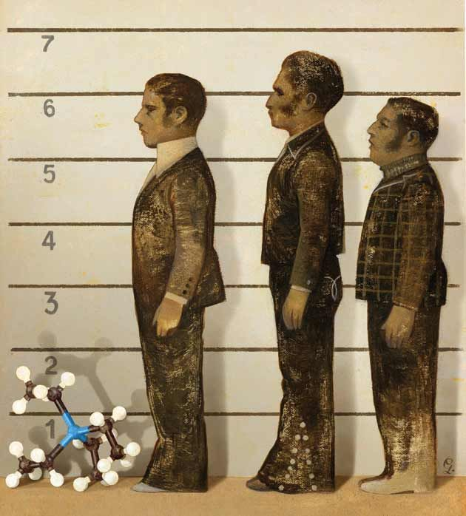
Crime & LEad
Source: Mother Jones

Slide 45
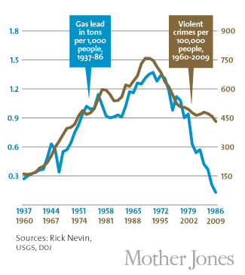

Slide 46
Making causation a good story

